Slide 1
Introduction to PLC’s
Programmable Logic Controller
By Kamlesh Bachkar

Slide 2
A programmable controller is a digital electronic apparatus with a programmable memory for storing instructions specific function, such as logic, sequencing, timing, counting, and arithmetic to control machines and processes.

Slide 3
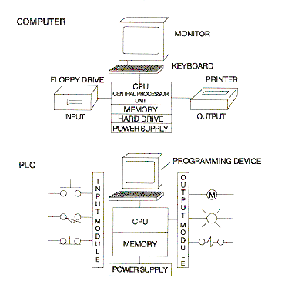

Slide 4
A typical PLC can be divided into four components:
Processor unit
Power supply
Input/output section
Programming device

Slide 5
Fixed I/O
PLC’s with fixed I/O typically come in a complete unit that contains the processor, I/O section, and power supply.

Slide 6
Modular I/O
is modular in nature, more flexible than fixed I/O units. The I/O rack or chassis is a framework or housing into which modules are inserted.

Slide 7
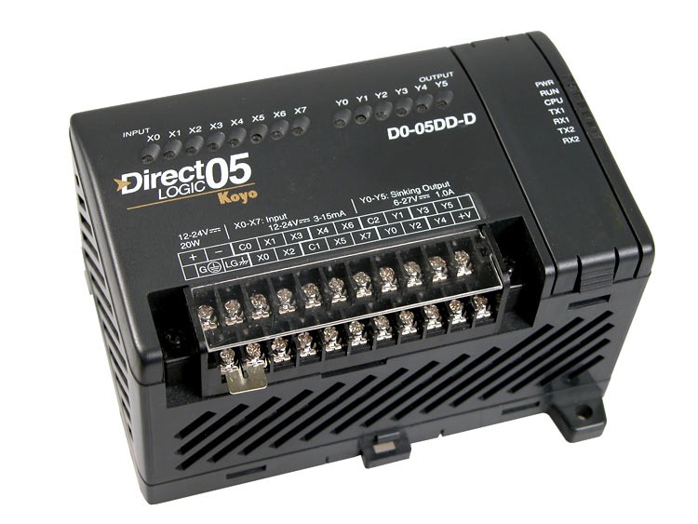
Fixed

Slide 8
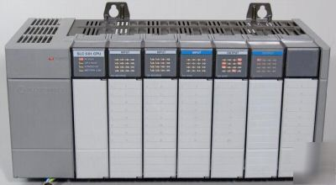
Modular

Slide 9
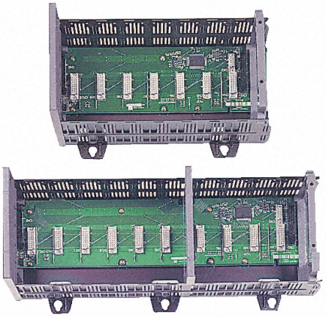
PLC,SLC-500 chassis

Slide 10
Racks or chassis come in many shapes & sizes, and typically allow 4, 8, 12, or 16 modules to be inserted. Racks contain I/O modules and the processor are referred to as local I/O. Racks that contain I/O modules, remote I/O communication cards, power supplies, and are mounted separately of away from the processor are referred to as remote I/O.

Slide 11
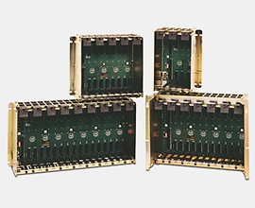
Allen-Bradley uses the rack number, location of a module within a rack, and the terminal number of a module to which an input or output device is connected to determine the device’s address.

Slide 12
Discrete I/O Modules
Discrete I/O modules are types of modules that only accept digital or ON- and OFF- type signals.
Discrete Input Module communicates the status of the various real-world input devices connected to the module (ON of OFF) to the processor.

Slide 13
Discrete I/O Modules
Pilot Duty Outputs
Outputs of this type typically are used to drive high-current electromagnetic loads such as solenoids, relays, valves, and motor starters. These loads are highly inductive and exhibit a large inrush current. Pilot duty outputs should be capable of withstanding an inrush current of 10 times the rated load for a short period of time without failure.
General - Purpose Outputs
These are usually low- voltage and low-current and are used to drive indicating lights and other non-inductive loads. Noise suppression may or may not be included on this types of modules.
Discrete Inputs
Circuits of this type are used to sense the status of limit switches, push buttons, and other discrete sensors. Noise suppression is of great importance in preventing false indication of inputs turning on or off because of noise.

Slide 14
Anaolog I/O Modules
Circuits of this type sense or drive analog signals.
Analog inputs come from devices, such as thermocouples, strain gages, or pressure sensors, that provide a signal voltage or current that is derived from the process variable.
Standard Analog Input signals: 4-20mA; 0-10V
Analog outputs can be used to drive devices such as voltmeters, X-Y recorders, servomotor drives, and valves through the use of transducers.
Standard Analog Output signals: 4-20mA; 0-5V; 0-10V

Slide 15
Special-Purpose I/O Modules
Circuits of this type are used to interface PLCs to very specific types of circuits such as servomotors, stepping motors PID (proportional plus integral plus derivative) loops, high-speed pulse counting, resolver and decoder inputs, multiplexed displays, and keyboards.
This module allows for limited access to timer and counter presets and other PLC variables without requiring a program loader.

Slide 16
Discrete I/O Modules
IS NEEDED TO:
Prevent voltage transients from damaging the processor.
Helps reduce the effects of electrical noise
USE TO DROP THE VOLTAGE TO LOGIC LEVEL
Current
Limiting
Resistor
Buffer, Filter, hysteresis Circuits
FROM INPUT
DEVICE
OPTO-
ISOLATOR
TO
PROCESSOR

Slide 17
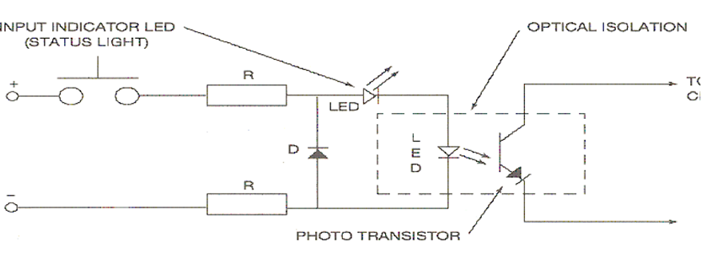
DC Discrete Input Modules

Slide 18
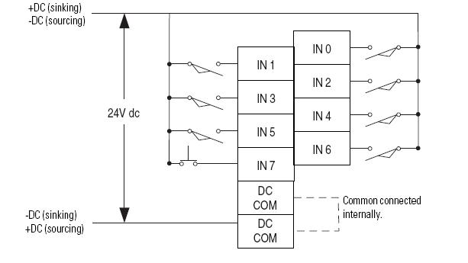
Input module wiring Diagram

Slide 19
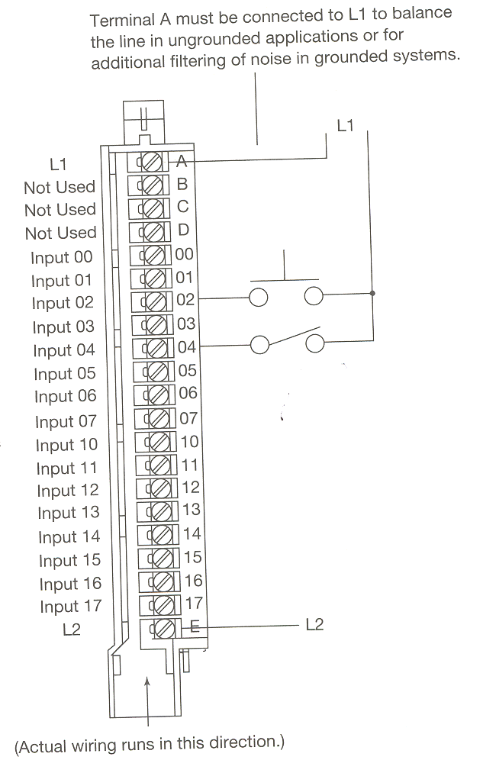

Slide 20
AC Discrete Input Module
IS NEEDED TO:
Prevent voltage transients from damaging the processor.
Helps reduce the effects of electrical noise
CONVERTS THE AC INPUT TO DC AND DROPS THE VOLTAGE TO LOGIC LEVEL
Rectifier,
Resistor
Network
Buffer, Filter, Hysteresis Circuits
FROM INPUT
DEVICE
OPTO-
ISOLATOR
TO
PROCESSOR

Slide 21
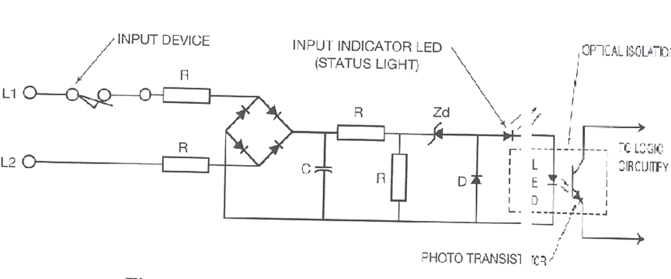
AC Discrete Input Module

Slide 23
Discrete Output Modules
The purpose of a discrete output module is to control the current flow to real-world devices such as motor starter coils, pilot lights, control relays, and solenoid valves.

Slide 24
Discrete DC Output

Slide 25
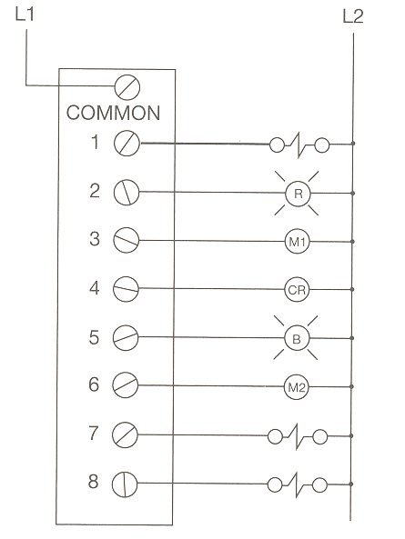

Slide 26
Discrete AC Output

Slide 28

Discrete Input Example
IN
OFF
Logic 0
PLC
Input
Module
24 V dc
IN
OFF
Logic 1
PLC
Input
Module
24 V dc

Slide 29
Analog I/O Modules
Analog input modules are used to convert analog signals from analog devices that sense such variables as temperature, light intensity, speed, pressure, and position to 12-bit binary or to 3-digit binary-coded decimal (BCD), depending on the manufacturer, for use by the processor.

Slide 30
Analog Input
An analog input is an input signal that has a continuous signal. Typical inputs may vary from 0 to 20mA, 4 to 20mA or 0 to10V. Below, a level transmitter monitors the level of liquid in the tank. Depending on the level Tx, the signal to the PLC can either increase or decrease as the level increases or decreases.
Level Transmitter
IN
Tank
PLC
Analog
Input
Module

Slide 31
Analog Output
An analog output is an output signal that has a continuous
signal. Typical outputs may vary from 0 to 20mA, 4 to 0mA
or 0 to10V.
OUT
E
Supply air
PLC
Analge
Output
Module
0 to 10V
P

Slide 32
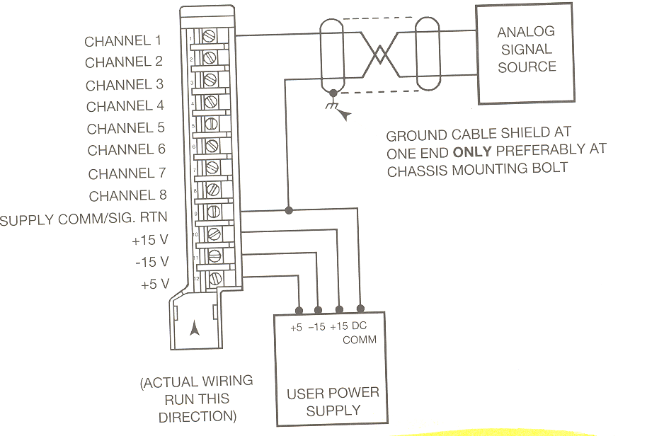

Slide 33
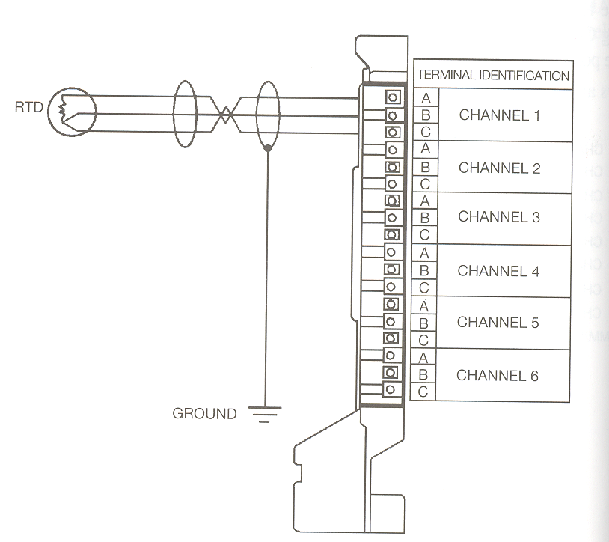

Slide 34
Sourcing and Sinking
This is the manner in which DC devices are wired.
In electronics, if a device (input module) provides current, or is the source of current, it is said to be sourcing.
If the device (input module) is receiving current, it is said to be sinking.

Slide 35
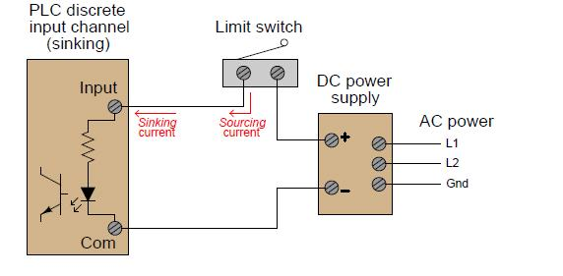
Input Module Sinking

Slide 36
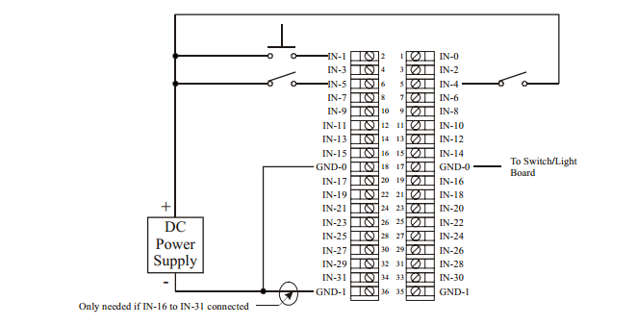
ControlLogix IB32 DC Input Module Connection (Sinking)

Slide 37
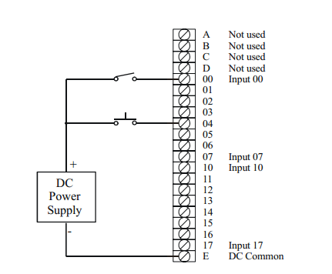
PLC-5 IBD DC Input Module Connection (Sinking)

Slide 38
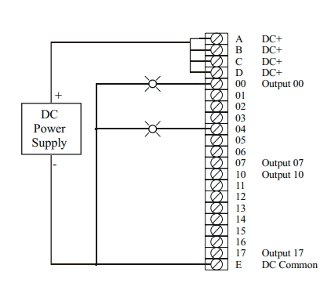
PLC-5 OBD DC Output Module Connection (Sourcing)

Slide 39
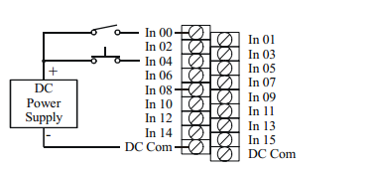
SLC-500 IB16 DC Input Module Connection (Sinking)

Slide 40
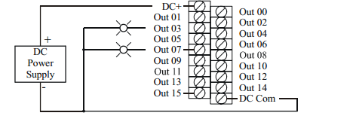
SLC-500 OB16 DC Output Module Connection (Sourcing)

Slide 41
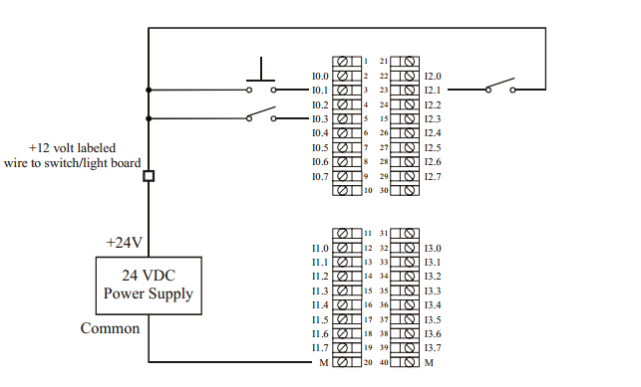
S7 SM321 DI32x24V DC Input Module Connection (Sinking)

Slide 42
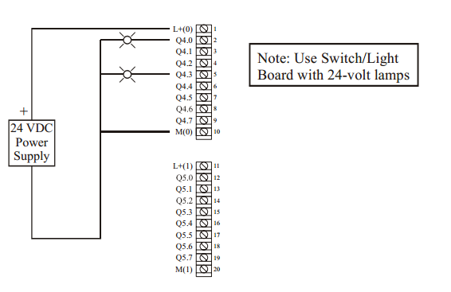
S7 SM322 DO16x24V DC Output Module Connection (Sourcing)

Slide 43
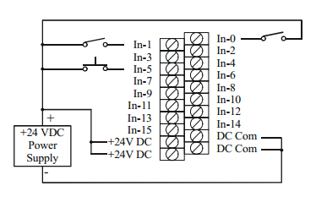
Modicon DDI 1602 24V DC Input Module Connection (Sinking)

Slide 44
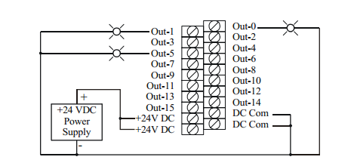
Modicon DDO 1602 24V DC Output Module Connection sourcing

Slide 45
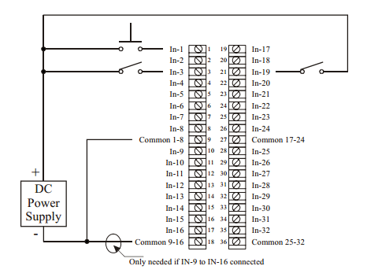
GE MDL 660 12/24V DC Input Module Connection (Sinking)

Slide 46
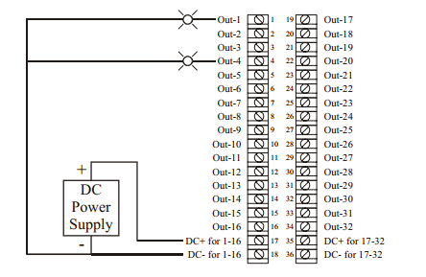
GE MDL 754 12/24V DC Output Module Connection sourcing

Slide 47
Interposing Relay
When it is necessary to control loads larger than the rating of an individual output circuit, a standard control relay, which has a small inrush and sealed current value, is connected to the output module.

Slide 48
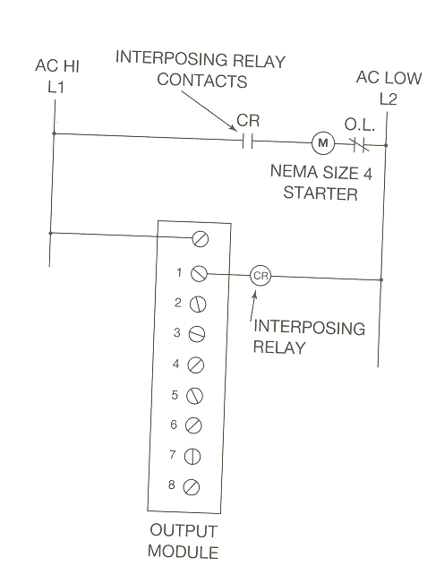

Slide 49
Processor
The processor module contains the PLC’s microprocessor, its supporting circuitry, and its memory system.
The main function of the microprocessor is to analyze data coming from field sensors through input modules, make decisions based on the user’s defined control program and return signal back through output modules to the field devices. Field sensors: switches, flow, level, pressure, temp. transmitters, etc. Field output devices: motors, valves, solenoids, lamps, or audible devices.
The memory system in the processor module has two parts: a system memory and an application memory.

Slide 50
Memory
VOLATILE.
A volatile memory is one that loses its stored information when power is removed.
Even momentary losses of power will erase any information stored or programmed on a volatile memory chip.
Common Type of Volatile Memory
RAM. Random Access Memory(Read/Write)
Read/write indicates that the information stored in the memory can be retrieved or read, while write indicates that the user can program or write information into the memory.

Slide 51
Memory
The words random access refer to the ability of any location (address) in the memory to be accessed or used. Ram memory is used for both the user memory (ladder diagrams) and storage memory in many PLC’s.
RAM memory must have battery backup to retain or protect the stored program.

Slide 52
Memory
NON-VOLATILE
Has the ability to retain stored information when power is removed, accidentally or intentionally. These memories do not require battery back-up.
Common Type of Non-Volatile Memory
ROM, Read Only Memory
Read only indicates that the information stored in memory can be read only and cannot be changed. Information in ROM is placed there by the manufacturer for the internal use and operation of the PLC.

Slide 53
Memory
Other Types of Non-Volatile Memory
PROM, Programmable Read Only Memory
Allows initial and/or additional information to be written into the chip.
PROM may be written into only once after being received from the PLC manufacturer; programming is accomplish by pulses of current.
The current melts the fusible links in the device, preventing it from being reprogrammed. This type of memory is used to prevent unauthorized program changes.

Slide 54
Memory
EPROM, Erasable Programmable Read Only Memory
Ideally suited when program storage is to be semi-permanent or additional security is needed to prevent unauthorized program changes.
The EPROM chip has a quartz window over a silicon material that contains the electronic integrated circuits. This window normally is covered by an opaque material, but when the opaque material is removed and the circuitry exposed to ultra violet light, the memory content can be erased.
The EPROM chip is also referred to as UVPROM.

Slide 55
Memory
EEPROM, Electrically Erasable Programmable Read Only Memory
Also referred to as E²PROM, is a chip that can be programmed using a standard programming device and can be erased by the proper signal being applied to the erase pin.
EEPROM is used primarily as a non-volatile backup for the normal RAM memory. If the program in RAM is lost or erased, a copy of the program stored on an EEPROM chip can be down loaded into the RAM.

Slide 56
Scanning
While the PLC is running, the scanning process includes the following four phases, which are repeated continuously as individual cycles of operation:
PHASE 1
Read Inputs
Scan
PHASE 2
Program
Execution
PHASE 3
Diagnostics/
Comm
PHASE 4
Output
Scan

Slide 57
Scanning
The time it takes to implement a scan cycle is called SCAN TIME. The scan time composed of the program scan time, which is the time required for solving the control program, and the I/O update time, or time required to read inputs and update outputs. The program scan time generally depends on the amount of memory taken by the control program and type of instructions used in the program. The time to make a single scan can vary from 1 ms to 100 ms.
As part of the processor’s internal self-diagnostic system, a watchdog timer is used. The watchdog timer is preset to an amount of time that is slightly longer than the scan time would be under normal conditions.

Slide 58
Safety Circuit
The National Electrical Manufacturing Association (NEMA) standards for programmable controllers recommends that consideration be given to the use of emergency-stop functions that are independent of the programmable controller.

Slide 59
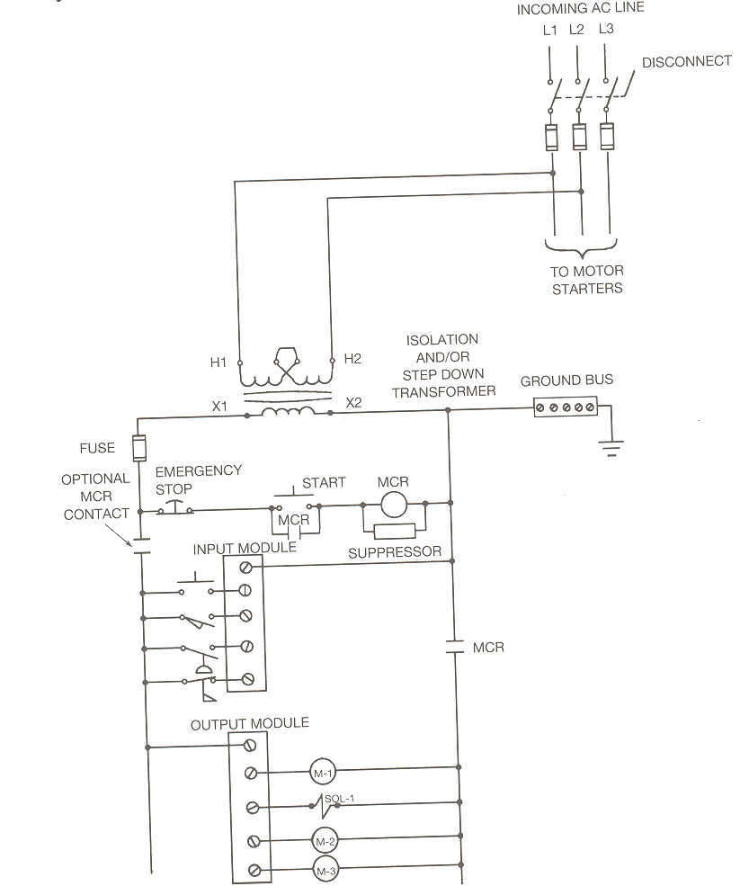

Slide 60
Rack Installation
Before installing a rack or chassis, consideration must be given to the following:
Temperature
Dust
Vibration
Humidity
Field wiring distances
Troubleshooting accessibility
The ambient temperature of the proposed location should not be lower than 32F or higher than 140F (0C and 60C).

Slide 61
Dust can also cause a problem in the I/O rack when it accumulates on the electronic components of the modules, power supply, or processor. Accumulated dust prevents the components from dissipating heat effectively.
Excessive vibration can also lead to early component failure.

Slide 62
Exposing electronic equipment to extremely high humidity environments over an extended period of time can reduce component life and affect operation.
By mounting the I/O rack close to the actual equipment, the amount of conduit, cable, and other associated wiring and labor costs will be decreased.

Slide 63
Safety Circuit
The National Electrical Manufacturing Association (NEMA) standards for programmable controllers recommends that consideration be given to the use of emergency-stop functions that are independent of the programmable controller.

Slide 65
Electrical Noise
Electrical noise is generated whenever inductive loads such as relays, solenoids, motor starters, and motors are operated by “hard contacts” such as push buttons, selector switches, and relay contacts. When the circuit to an inductive load is opened, much of the energy stored in the load must be dissipated as arcing at the contacts unless some alternative means of energy absorption is provided.

Slide 66
Electrical Noise
Isolation of the electrical noise is accomplished by installing and isolation transformer for the PLC system to supply the power for the controller and the input circuits.
A second method in reducing EMI is to install surge suppression networks or devices on the individual motor starters, motors, and soleniods.

Slide 67
Electrical Noise
A surge protector limits the voltage supplied to an electric device by either blocking or by shorting to ground any unwanted voltages above a safe threshold.
With solid-state control systems, proper grounding helps eliminate the effects of electromagnetic induction.

Slide 68
Electrical Noise
Certain I/O modules such as TTL, analog, and thermocouples require shielded cable to reduce the effects of electrical noise.
When installing shielded cable, it is important that the shield only be grounded at one end.

Slide 69
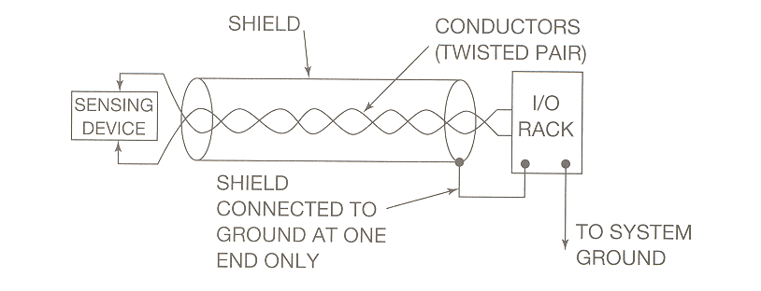

Slide 70
Guarding Against Electrostatic Discharge (ESD)
1) use nonstatic floor coverings
2) Handle chips correctly
3) Ground the work surface
4) wear a wrist strap

Slide 71
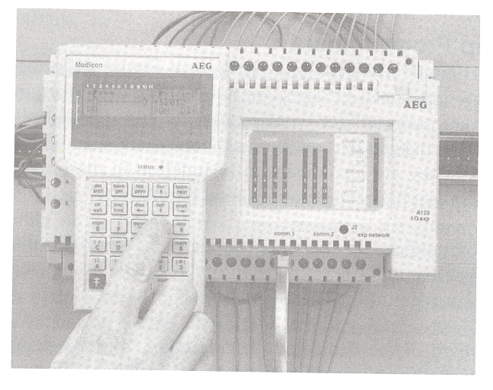
A programming device is needed to enter, modify, and troubleshoot the PLC program, or to check the condition.

