Slide 1
Robots & their Application
By
Kamlesh Bachkar

Slide 2
Syllabus Module 6
Robots and their applications:
Introduction to robots, Types, Classifications, Selection of robots, Robot Degrees of freedom, Robot configuration,
Accuracy and repeatability, Specification of a robot, Robot feedback controls: Point to point control and Continuous path control, Control system for robot joint,
Adaptive control, Drives and transmission systems, End effectors,
Industrial robot applications of robots
Link to NPTEL Course

Slide 3
Introduction
Origin of the word robot in 1923 — Translation of Czech play R. U. R.(Rossum’s Universal Robot, 1921) by Karel Capek (Capek, 1975).
From Czech word ‘robota’ meaning slave labour!
Designed to replace human beings, and depicted as very efficient and lacking emotion– Even now this description is prevalent!
Asimov (Asimov, 1970) in Round about coins robotics in his three laws of robotics— Robots are portrayed as harmless and in control of humans!
First industrial robot patent in 1954 by George C. Devol (US Patent No. 2,988,237) for Universal Automation or Unimation.
First robot by Unimation, Inc. (Founded by J. Engelbergerand George C. Devol) called Unimate– Used by General Motors at Trenton, New Jersey automobile plant for die-cast handling and spot welding.

Slide 4
Robotics
Definition
  The branch of technology that deals with the design, construction, operation, and application of robots.
  Robotics is a branch of engineering that involves the conception, design, manufacture, and operation of robots. This field overlaps with electronics, computer science, artificial intelligence, mechatronics, nanotechnology and bioengineering.
Need…..??
Utility …..??

Slide 5
IMPORTANT DATES IN HISTORY OF ROBOTS
1770 – Mechanism-driven life-like machines that can draw, play instruments, and clocks made in Germany and Switzerland.
1830 – Cam programmable lathe invented.
1921 – Premier of Karel Capek’s play R.U.R.
1942 – Asimov coins the word ‘robotics’ and gives his three laws of robotics.
1946 – ENIAC, the first electronic computer, developed at the University of Pennsylvania.
1947 – First electric powered tele-operated robot at MIT.
1948 – Book on feedback control, Cybernetics, written by Prof. Norbert Weiner of MIT.
1948 – Transistor invented at Bell Laboratories.
1952 – IBM’s first commercial computer, IBM 701.
1954 – First programmable robot patented and designed by Devol.

Slide 6
IMPORTANT DATES IN HISTORY OF ROBOTS
1955 – Paper by J. Denavit and R. S. Hartenberg (1955) provides a convention to describe links and joints in a manipulator.
1959 – Unimation Inc. founded by Engelberger; CNC lathe demonstrated at MIT.
1961 – General Motors buys and installs the first Unimate at a plant in New Jersey to tend a die casting machine.
1968 – Shakey, first mobile robot with vision capability, made at SRI.
1970 – The Stanford Arm designed with electrical actuators and controlled by a computer.
1973 – Cincinnati Milacron’s (T3) electrically actuated, mini-computer controlled industrial robot.
1976 – Viking II lands on Mars and an arm scoops Martian soil for analysis.
1978 – Unimation Inc. develops the PUMA robot — even
now seen in University labs!

Slide 7
IMPORTANT DATES IN HISTORY OF ROBOTS
1981 – Robot Manipulators by R. Paul, one of the first textbooks on robotics.
1982 – First educational robots by Microbot and Rhino.
1983 – Adept Technology, maker of SCARA robot, started.
1995 – Intuitive Surgical formed to design and market surgical robots.
1997 – Sojourner robot sends back pictures of Mars; the Honda P3 humanoid robot, started in 1986, unveiled.
2000 – Honda demonstrates Asimo humanoid robot capable of walking.
2001 – Sony releases second generation Aibo robot dog.
2004 – Spirit and Opportunity explore Mars surface and detect evidence of past existence of water.
2007 – Humanoid robot Aiko capable of “feeling” pain.
2009 – Micro-robots and emerging field of nano-robots marrying biology with engineering.

Slide 8
Anatomy of Industrial robots
Classes of robots
  robotic aircraft
  robotic ships
  mobile robots
  Many more
application of robots
  machine tending
  Welding
  Painting
  Assembly
  These “industrial robots” can be viewed as consisting of a mechanical portion “the manipulator” controlled by a microprocessor.

Slide 9
Subsystems of industrial robots
Actuators
Transmission systems
Power supplies & power storage system
Sensors and Electronics
Microprocessors & controllers
Algorithms & software's
Output
  Control of individual motors and actuators.
  Planning trajectory & individual actuators in motion.
  Planning trajectories of end effector.
  Acting upon sensors input
  Planning tasks

Slide 10
Types of Industrial Robots
Articulated
Cartesian
Cylindrical
Polar
SCARA
Delta

Slide 11
Types of Industrial Robots
Articulated
  Rotary joints – simple two joint structures to 10 or more joints.
  The arm is connected to the base with a twisting joint.
  The links in the arm are connected by rotary joints.
  Each joint is called an axis and provides an additional degree of freedom, or range of motion.
  Industrial robots commonly have four or six axes.
Cartesian
  These are also called rectilinear or gantry robots.
  Cartesian robots have three linear joints that use the Cartesian coordinate system (X, Y, and Z).
  They also may have an attached wrist to allow for rotational movement.
  The three prismatic joints deliver a linear motion along the axis.

Slide 12
Types of Industrial Robots
Cylindrical
  The robot has at least one rotary joint at the base and at least one prismatic joint to connect the links.
  The rotary joint uses a rotational motion along the joint axis, while the prismatic joint moves in a linear motion.
  Cylindrical robots operate within a cylindrical-shaped work envelope.
Polar
  Also called as spherical robots, in this configuration the arm is connected to the base with a twisting joint and a combination of two rotary joints and one linear joint.
  The axes form a polar coordinate system and create a spherical-shaped work envelope.

Slide 13
Types of Industrial Robots
SCARA (Selective Compliance Adaptive Robot Arm )
  Commonly used in assembly applications, this selectively compliant arm for robotic assembly is primarily cylindrical in design.
  It features two parallel joints that provide compliance in one selected plane.
Delta
  These spider-like robots are built from jointed parallelograms connected to a common base.
  The parallelograms move a single EOAT(End of Arm Tooling) in a dome-shaped work area.
  Heavily used in the food, pharmaceutical, and electronic industries, this robot configuration is capable of delicate, precise movement.

Slide 14
Types and Classification of Robot
Various ways of classifying a robot
  Fixed or mobile.
  Serial or parallel.
  According to degree of freedom (DOF).
  Rigid or flexible.
  Control — Point-to-point, autonomy and “intelligence”.
Most older industrial robots
  Fixed base and consisting of links connected by actuated joints.
Many modern robots can move on factory floors, uneven terrains or even walk, swim and fly

Slide 15
Types and Classification of Robot
Parameters for Classification
  By power source
  By the shape of the work envelope
  By the size of the robot
  By the weight it can move
  By the type of jobs it is optimized for
  By the type of drive system used to move the robot

Slide 16
Types and Classification of Robot
Power Source
  Electrical
  Hydraulic
  Pneumatic
  Nuclear
  Green
    Solar
    Wind
    Organic sources
    Natural heat sources

Slide 17
Geometry of the Work Envelope
Cartesian
Cylindrical
Spherical
Articulated
SCARA
Horizontally Base-Jointed Arm
Delta

Slide 18
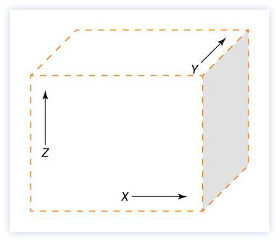
Cartesian Geometry
These systems have a cubic or rectangular work envelope
Many gantry-type robots fall into this group
These robots often have two or three major axes to move in:
  X is front to back
  Y side to side
  Z up or down
When there are only two major axes, X is often the one omitted

Slide 19
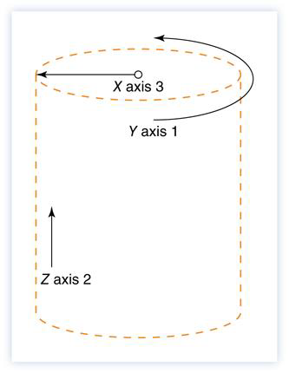
Cylindrical Geometry
The work envelope of these robots resembles a cylinder
These robots commonly have a rotary axis on the base to spin the robot, two linear axes to move the tooling into the general work area, and then two or three minor axes for tooling orientation.
These systems are good for reaching deep into machines, save on floor space, and tend to have the rigid structure needed for large payloads

Slide 20
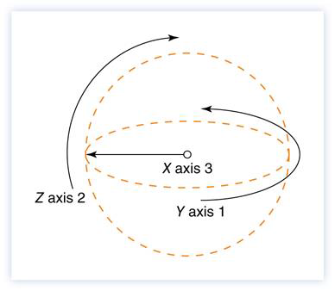
Spherical Geometry
This robots work envelop is a ball, cut off by where the robot mounts
Spherical, or polar, geometry, gives the user a wide range of options for robot positioning
The primary difference between cylindrical and spherical robots is that the spherical units have a long reach with a smaller size
Remember with the spherical robot you will not have the full ball, part of it will be cut off by what the robot mounts to and the surfaces around that

Slide 21
Articulated Geometry
Articulated robots have a spherical-type envelope that is constrained by the construction of the robot
The articulated robot leaves linear motion behind for rotational motion at the various axes
This robot is also known as jointed arm, revolute, and even anthropomorphic, because in many cases, its motions look very organic and lifelike
It has a chunked-up portion of the spherical envelope due to the robot design and limitations of the system

Slide 22
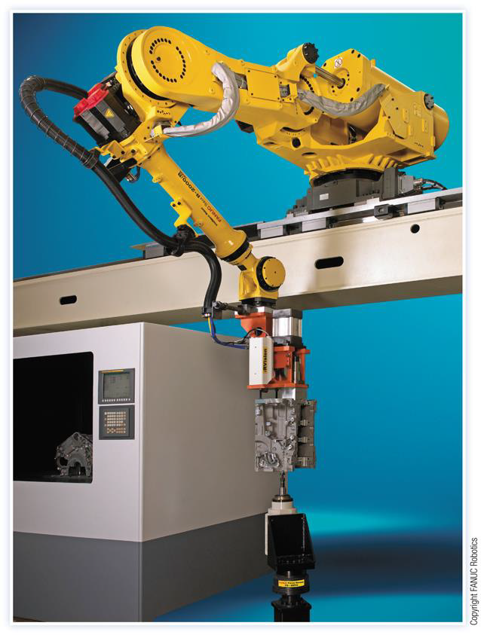
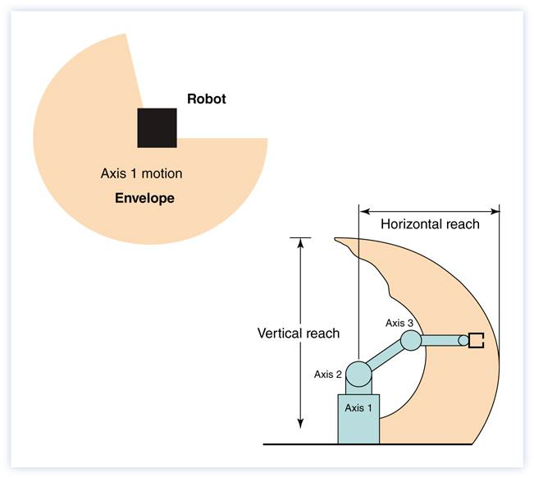
Articulated Geometry
To the right is an articulated geometry robot, a favorite of industry. Above is an illustration showing the work envelope of this type of robot

Slide 23
SCARA
Selective Compliance Articulated Robot Arm (SCARA)is unique in that it combines Cartesian linear motion with the rotation of an articulated system, creating a new motion type.
SCARA has a cylindrical geometry with axes 1 and 2 moving in a rotational manner and axis 3 moving in a linear vertical way to manipulate the tooling into position while applying force.

Slide 24
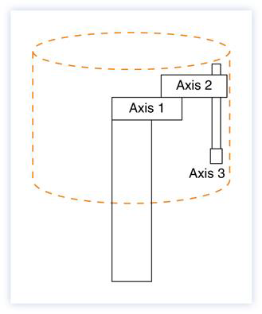
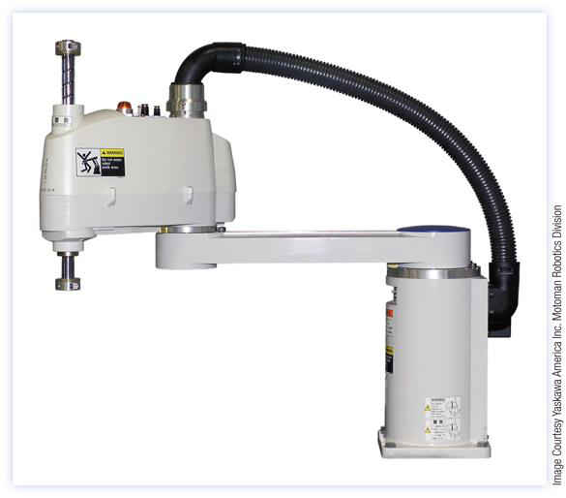
SCARA

Slide 25
DEGREE-OF-FREEDOM (DOF)
Degree of freedom (DOF) determines capability of a robot and number of actuated joints 6 (DOF) required for arbitrary task in 3D.
Painting and welding can be done by 5 DOF robot.
Electronics assembly usually done by 4 DOF SCARA robot.
For extra flexibility/working volume, 5 or 6 DOF robot mounted on 2 or 3 DOF gantry or wheeled mobile robot.
Redundant robot with more than 6 DOF for avoiding obstacles, more flexibility etc.
Arrangement of first three joints (in fixed serial robots) are classified as:
  Cartesian
  Spherical
  Cylindrical
  Anthropomorphic — Human arm like.
SCARA or Selective Compliance Adaptive Robot Arm
  Extensively used in electronic assembly.
  Last three joints form a wrist — Orients the end-effector.

